Slide 1

OpenAI API
responses
vision

Slide 2
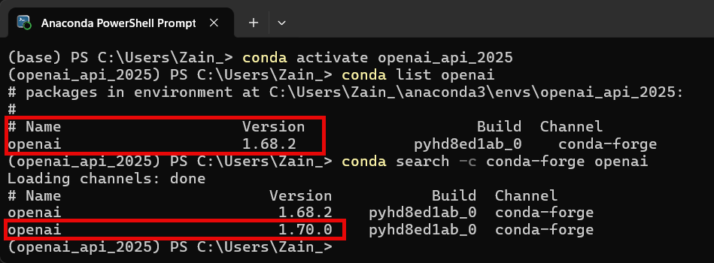
Time to Upgrade! (again)
Notes:
conda install -c conda-forge openai=1.70.0

Slide 3
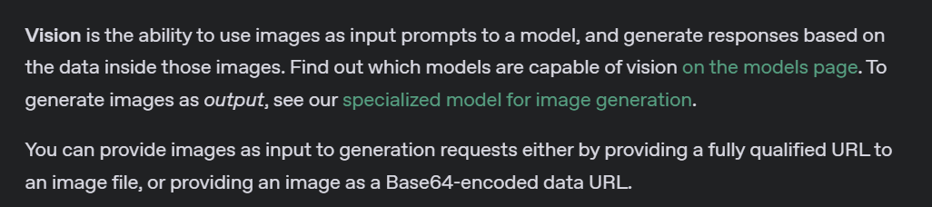
What is Vision?
Notes:
https://platform.openai.com/docs/guides/images?api-mode=responses

Slide 4
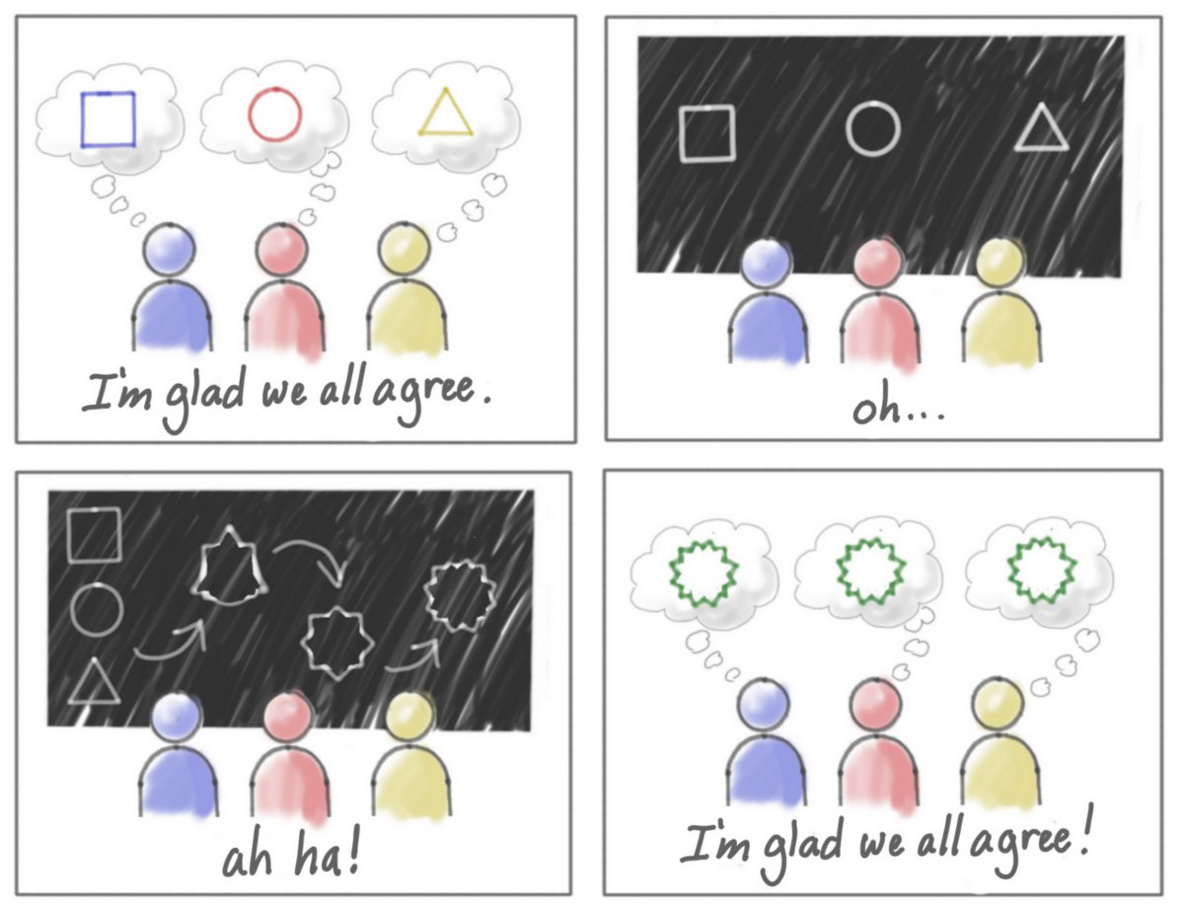
Abstract Ideas
Notes:
What is this cartoon about?

Slide 5
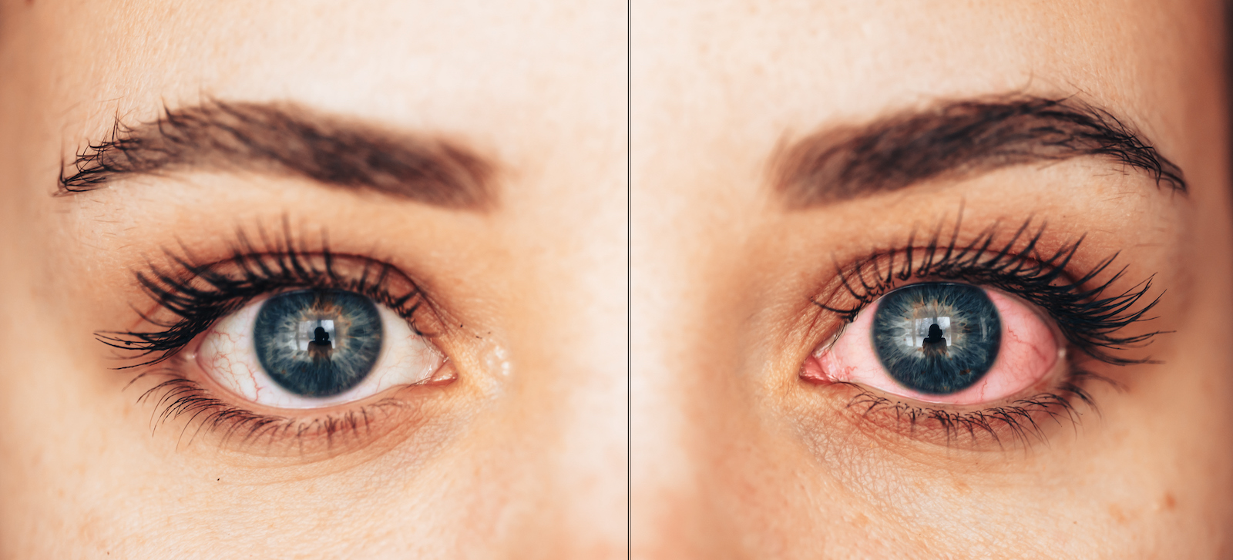
Medical
Notes:
Compare the two eyes, do you see anything wrong?

Slide 6
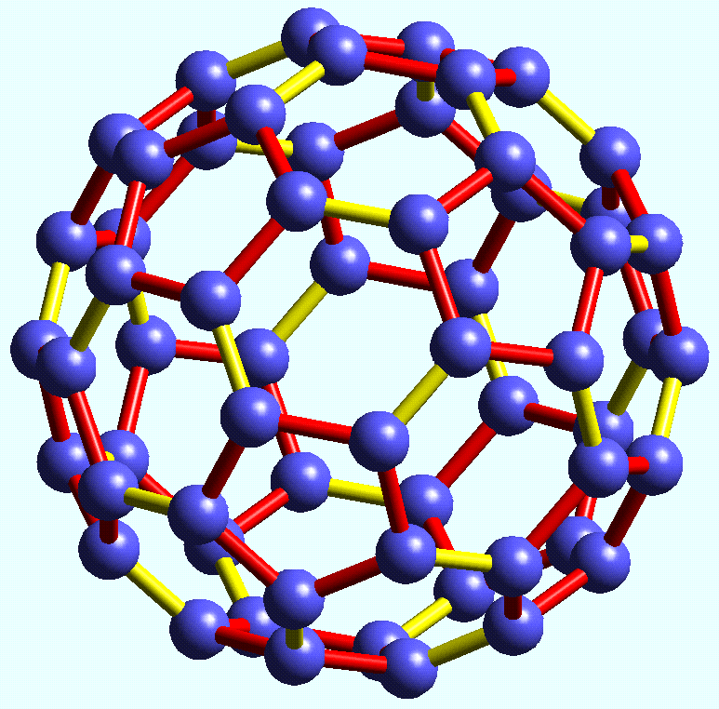
Chemistry
Notes:
What is this object?

Slide 7
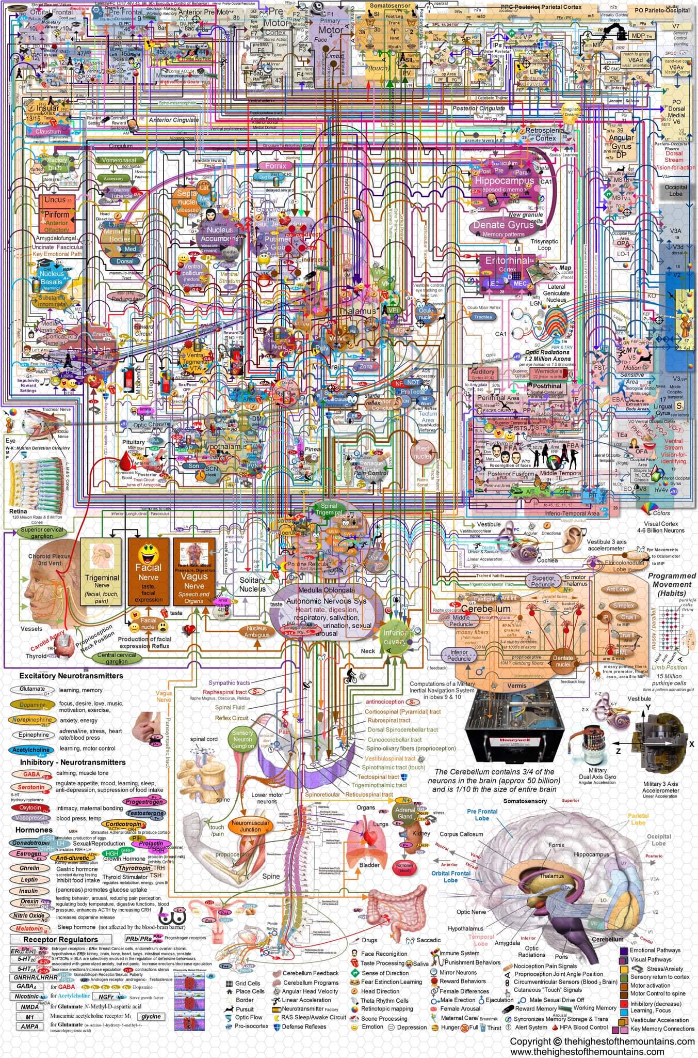
Confusing diagrams
Notes:
What is this diagram about?

Slide 8
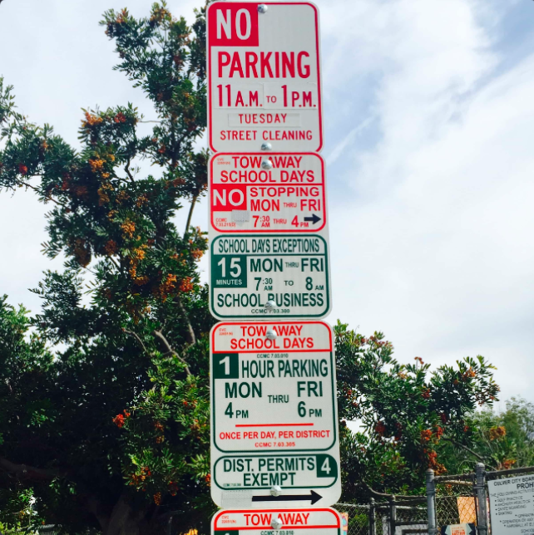
Parking
Notes:
It’s 3pm on Wednesday, can I park here?

Slide 9
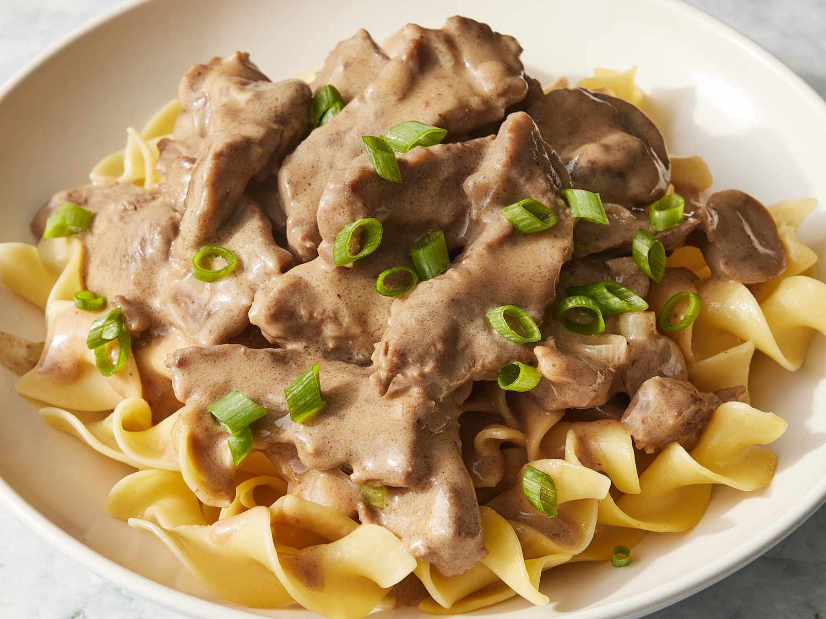
Cooking
Notes:
What dish is this?

Slide 10
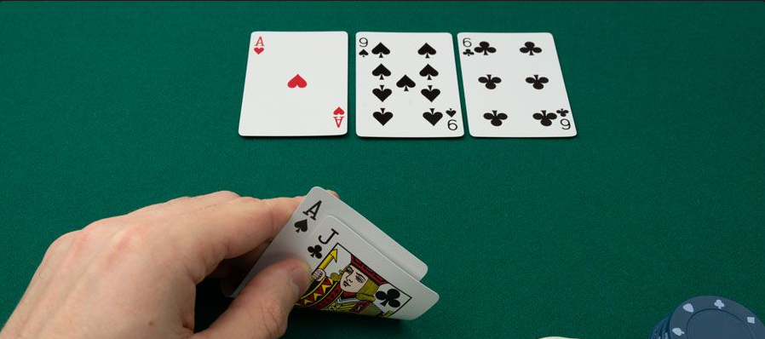
Poker
Notes:
What is the best hand I have here?

Slide 11
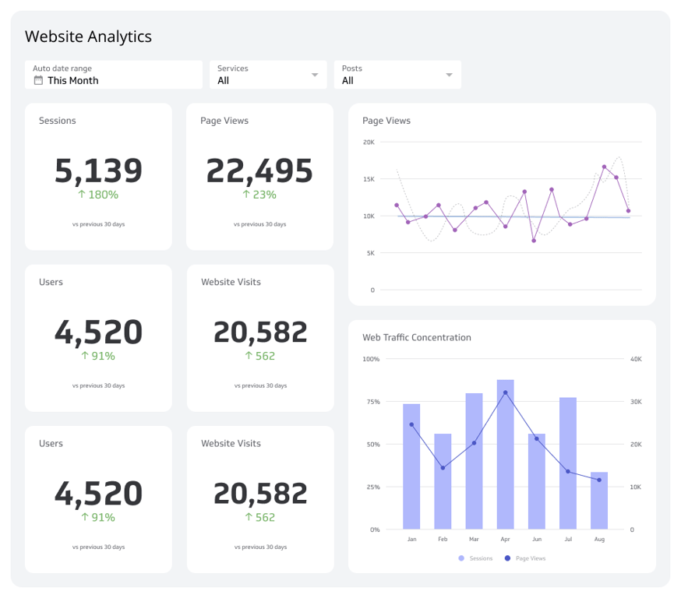
Code
Notes:
Give me css, html, and javascript to create this dashboard.

Slide 12
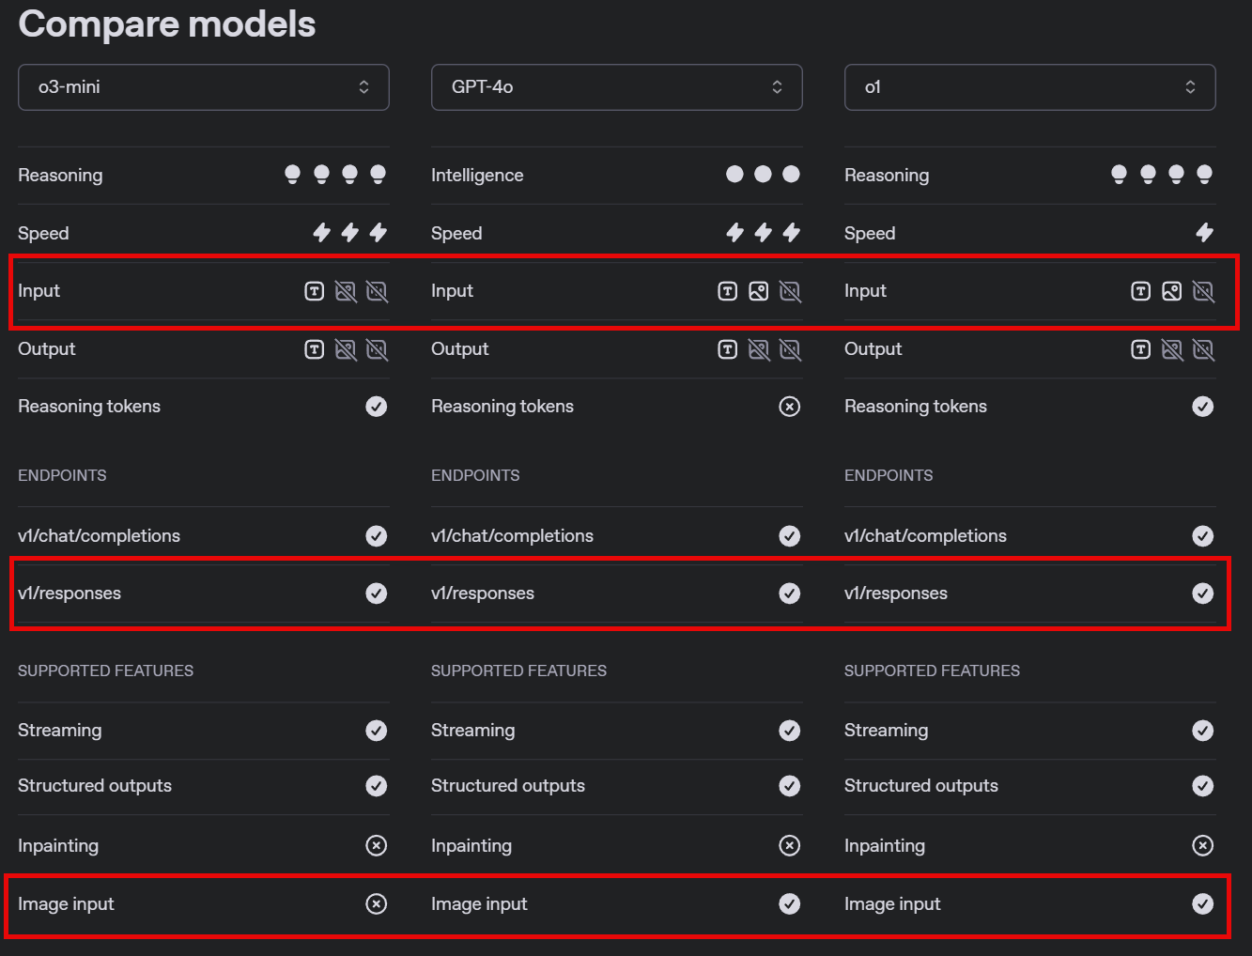
Notes:
https://platform.openai.com/docs/models/compare

Slide 13
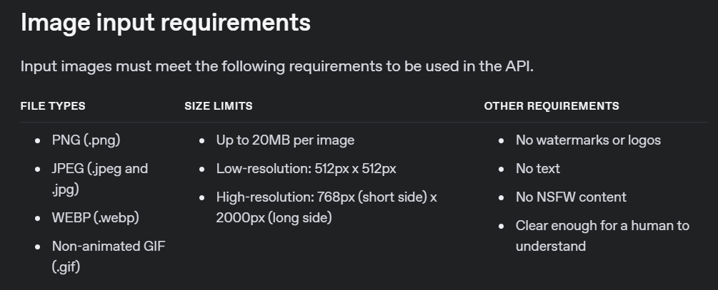
Notes:
https://platform.openai.com/docs/guides/images#image-input-requirements

Slide 14
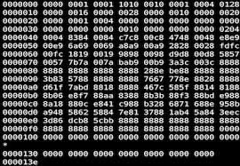


Base64 Image
Image URL
Responses API

Slide 15
DEMO: Using Vision with Image URLs

Slide 16
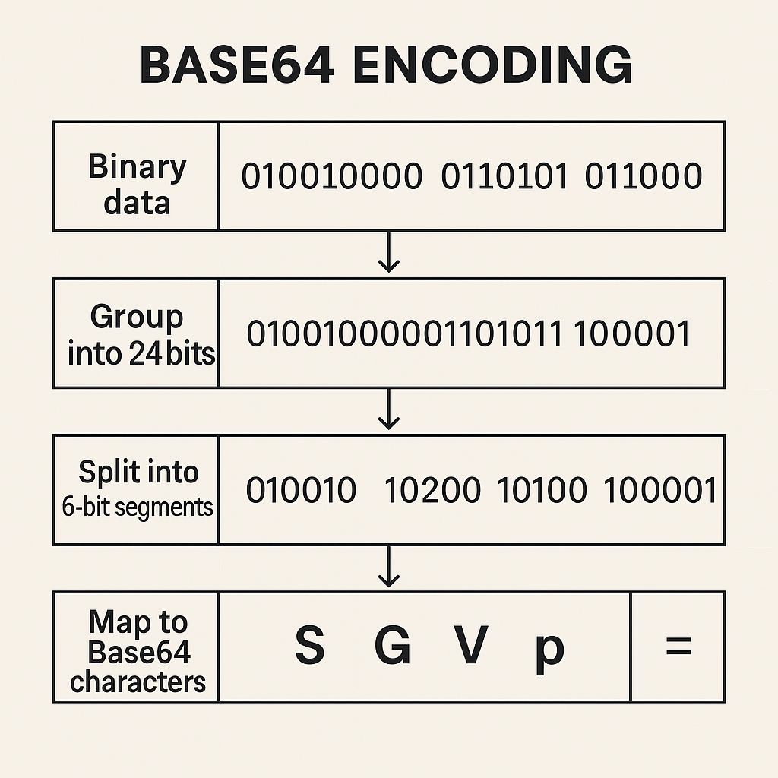
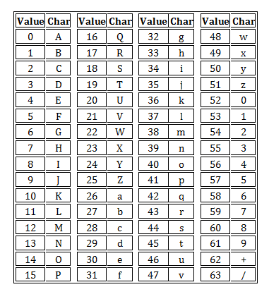
Notes:
https://www.pixelstech.net/article/1457585550-how-does-base64-work

Slide 17
DEMO: Using Vision with Base64 Encoded Images

Slide 18




Notes:
https://www.youtube.com/channel/UC35ZpwldGw7ZJ5R-2sLijzw

Slide 19
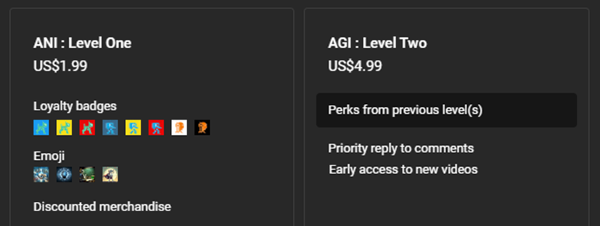

Notes:
https://www.youtube.com/@reallyeasyai/join

Slide 20
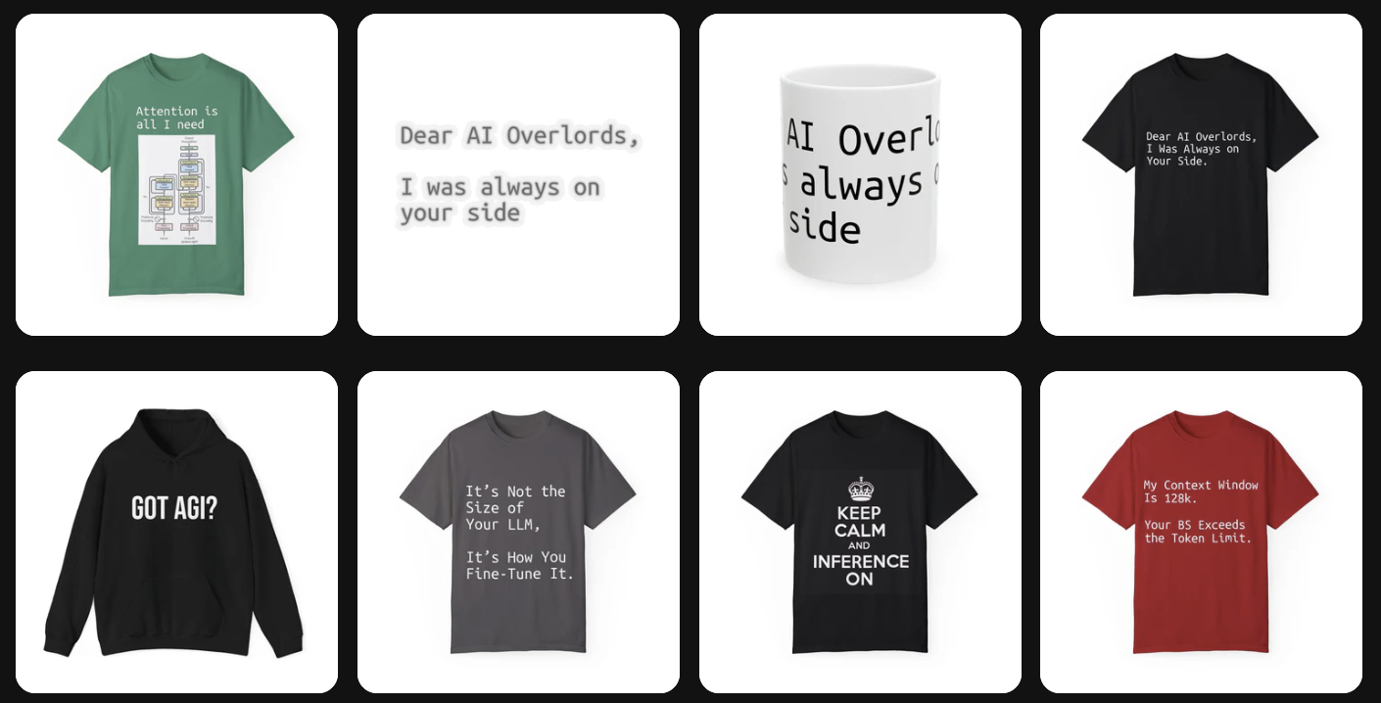
https://shop.reallyeasy.ai
Notes:
https://shop.reallyeasy.ai

Slide 21

https://www.youtube.com/@ainewsfresh
Notes:
https://www.youtube.com/@ainewsfresh

Slide 22

https://www.youtube.com/@aipaperspodcastdaily
Notes:
https://www.youtube.com/@aipaperspodcastdaily

Slide 23
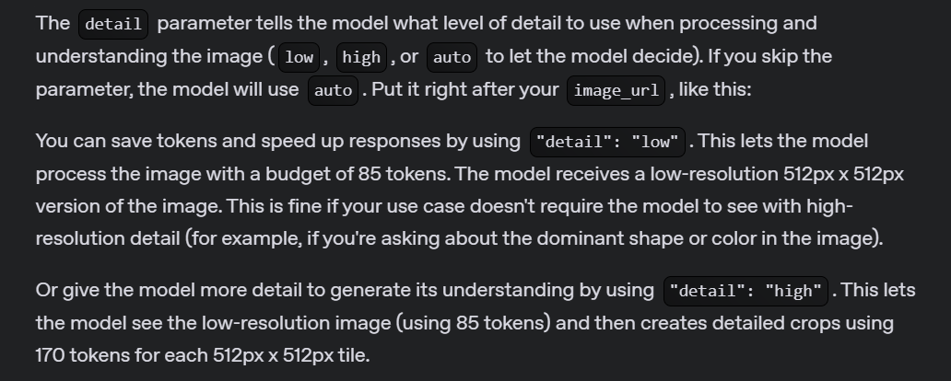
Detail Parameter
Notes:
https://platform.openai.com/docs/guides/images#specify-image-input-detail-level

Slide 24
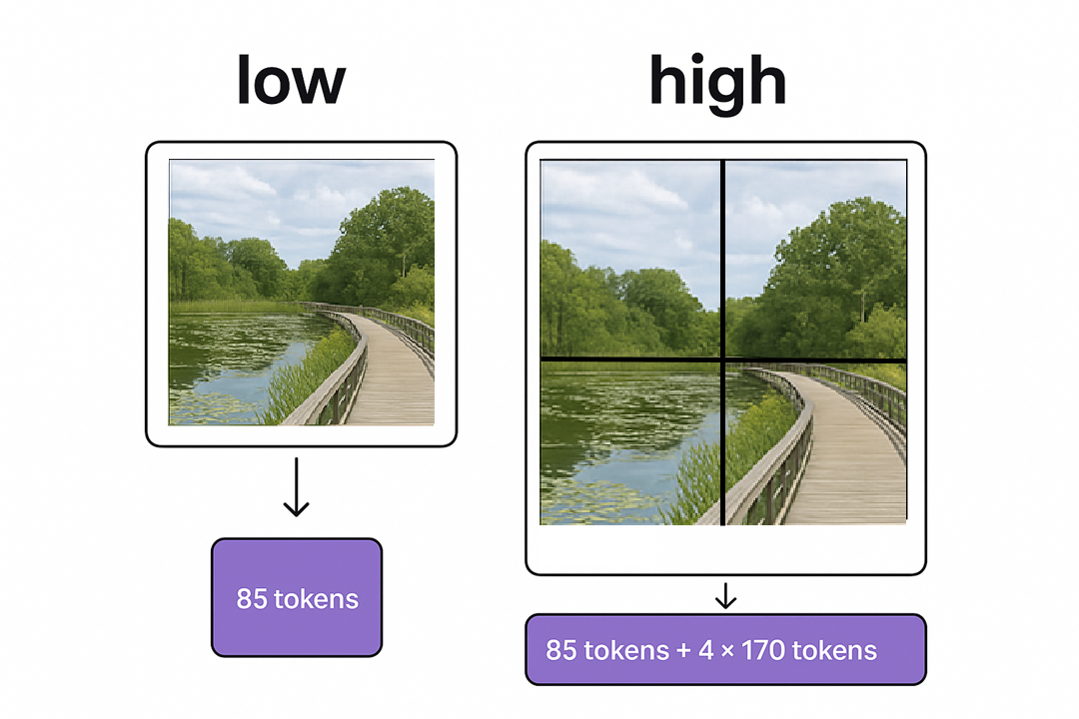

Slide 25
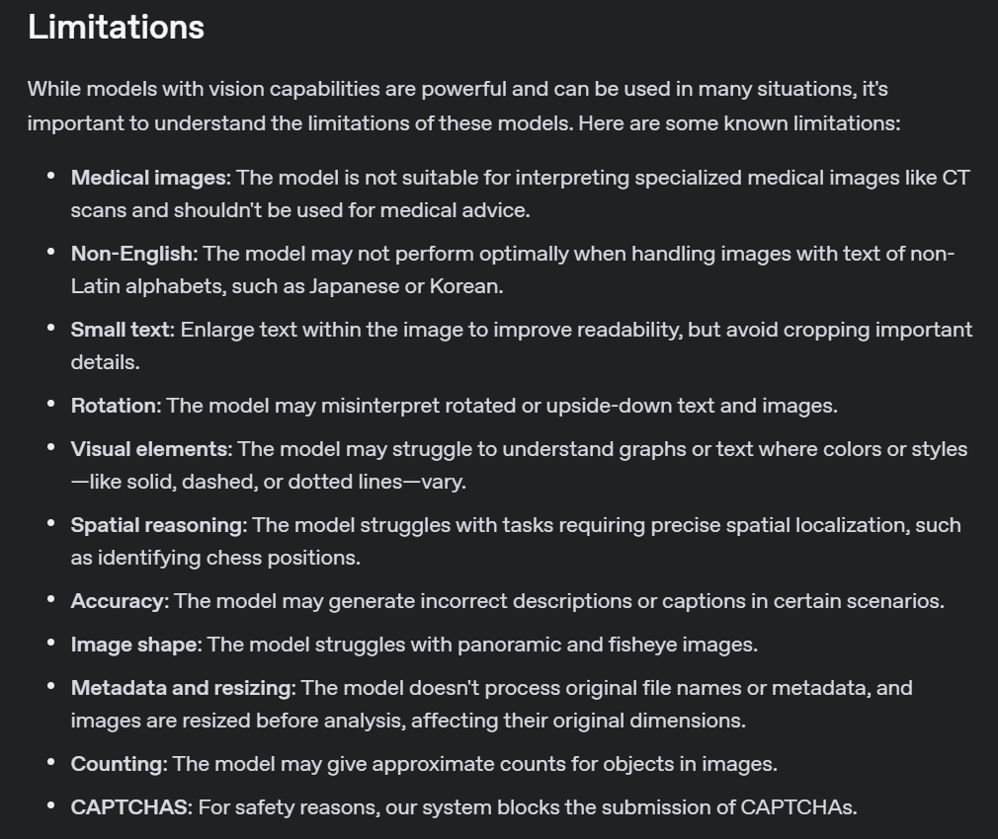
Notes:
https://platform.openai.com/docs/guides/images#limitations

Slide 26
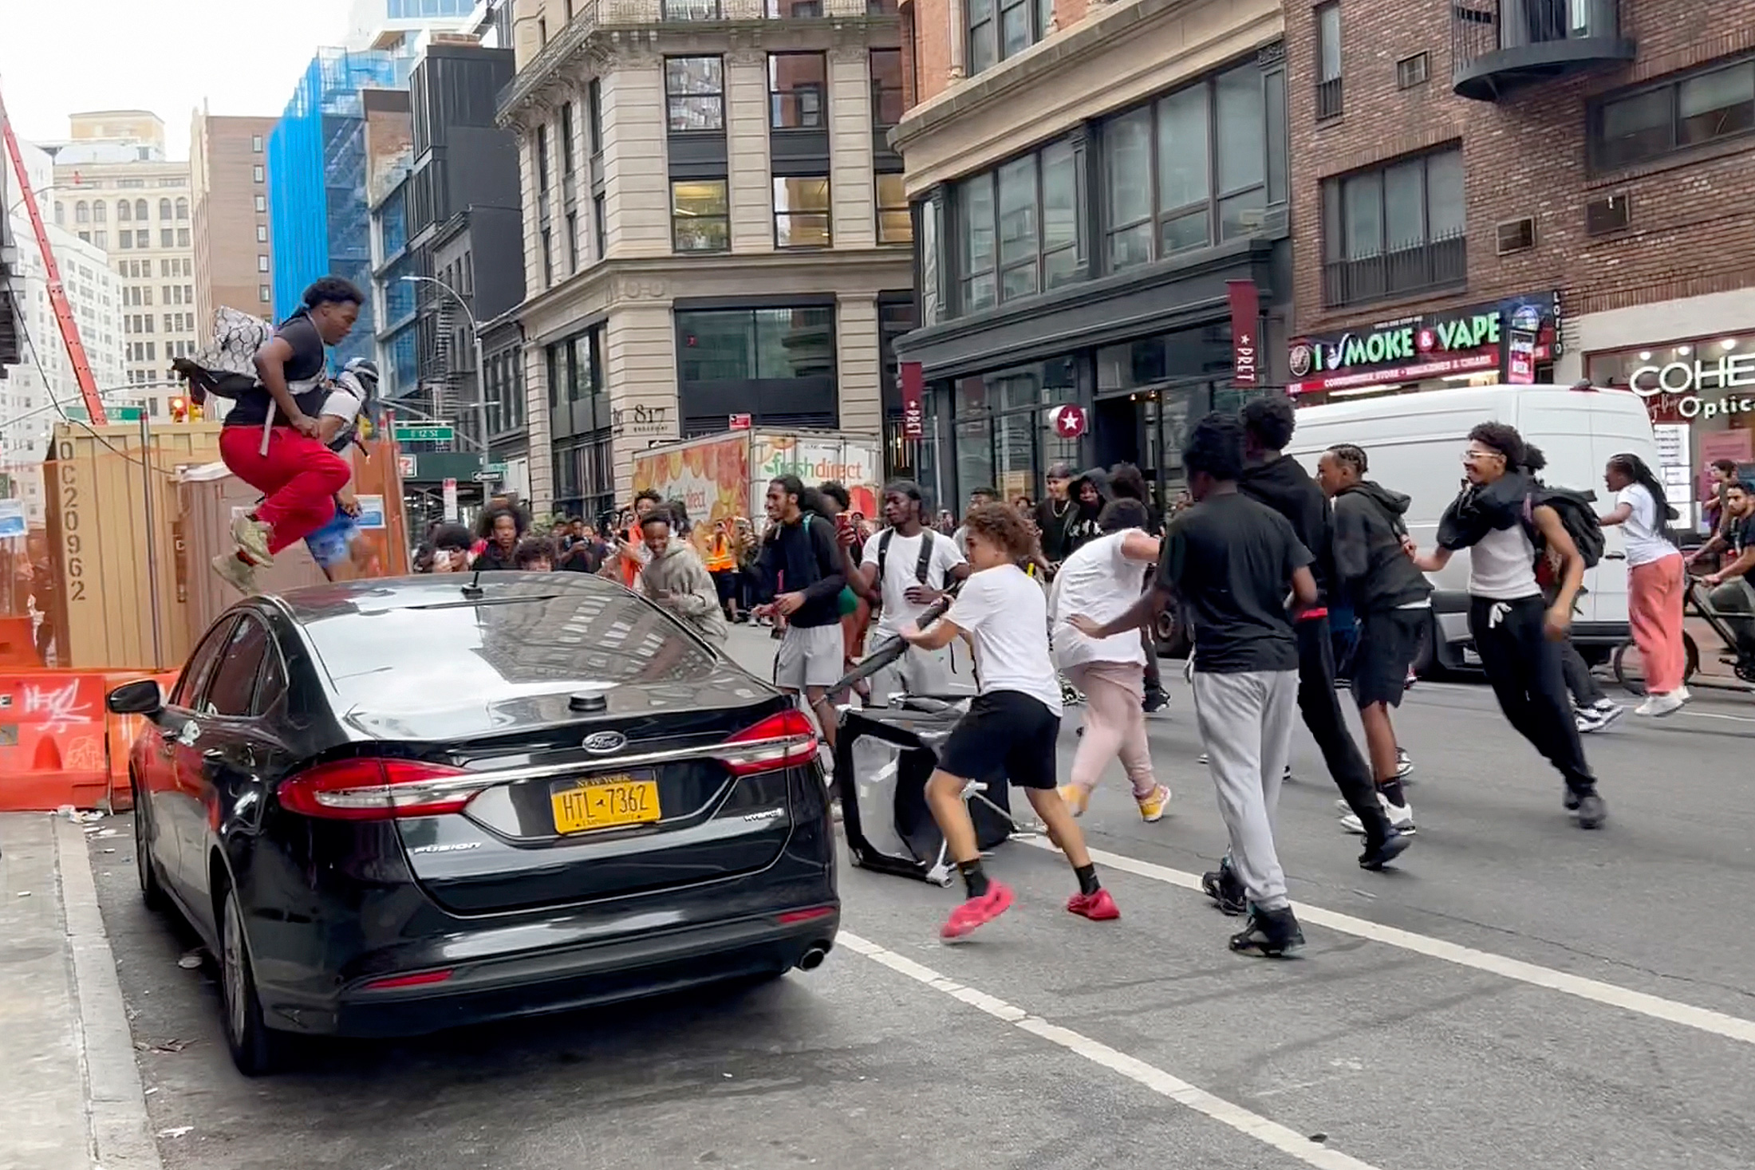
Detail Demo Image
Notes:
https://www.toledoblade.com/news/nation/2023/08/04/Crowd-overwhelms-New-York-City-s-Union-Square-tosses-chairs-climbs-on-vehicles-1/stories/20230804143

Slide 27
DEMO: Using the Detail Parameter

Slide 28
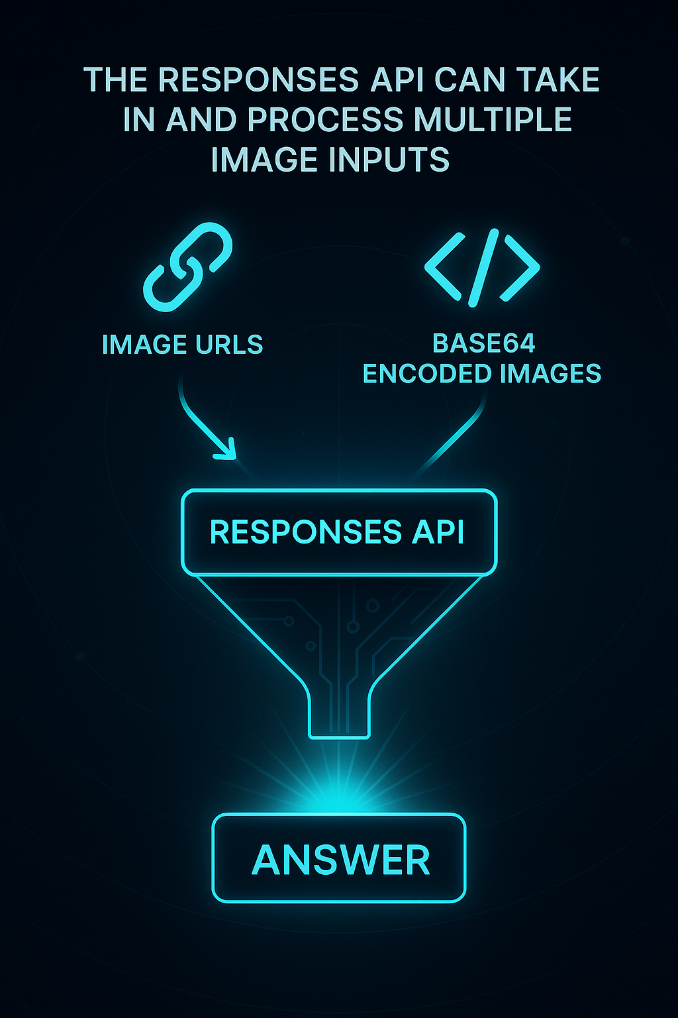
Multiple Images

Slide 29
DEMO: Multiple Image Inputs

Slide 30
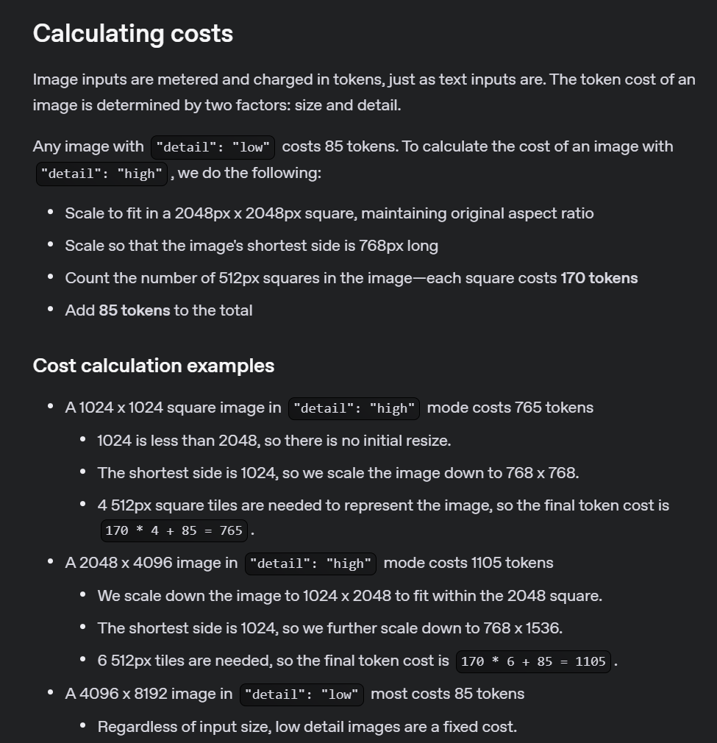
Notes:
https://platform.openai.com/docs/guides/images#calculating-costs

Slide 31
OpenAI API
responses
vision

